Slide 1
Training Feed-Forward Neural Networks
Unit 3.1
MDS 655

Slide 2
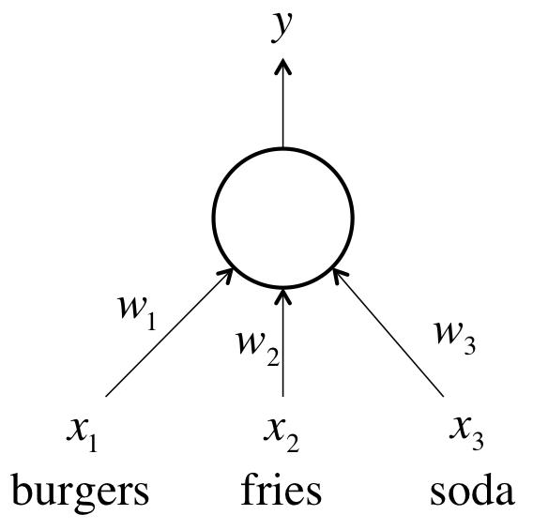
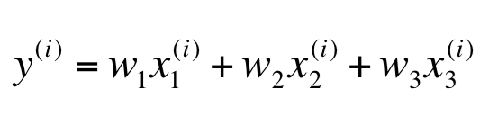
Fast Food Problem
Every single day, we purchase a restaurant meal consisting of burgers, fries, and sodas
We buy some number of servings for each item
We want to be able to predict how much a meal is going to cost us, but the items don’t have price tags.

Slide 3
Fast Food Problem (continued…)
How to solve fast food problem?
Preparing appropriate training set. ( mixture of different servings like 1-1-1 for breakfast, lunch, dinner or 1-2-1, 2-1-2, 3-1-2 and so on…)
Adjustment of parameter vector θ (weights)
Minimization of error

Slide 4

Fast Food Problem (continued…)
we want to minimize the value of the error function E
The squared error is zero when our model makes a perfectly correct prediction on every training example.
Moreover, the closer E is to 0, the better our model is.
Parameter vector θ (the values for all the weights in our model) should be chosen such that E is as close to 0 as possible.

Slide 5
Gradient Descent

Slide 6
Gradient Descent (Continued…)
Visualizing the error surface as a set of contours

Slide 7
Contours correspond to settings of w1 and w2 that evaluate to the same value of E.
The closer the contours are to each other
the steeper the slope
direction of the steepest descent is always perpendicular to the contours.
This direction is expressed as a vector known as the gradient.

Slide 8
Gradient Descent (Continued…)
Gradient Descent Algorithm
Randomly initialize the weights of our network so we find ourselves somewhere on the horizontal plane.
By evaluating the gradient at our current position
we can find the direction of steepest descent
and we can take a step in that direction.

Slide 9
Gradient Descent (Continued…)
Then we’ll find ourselves at a new position that’s closer to the minimum than we were before.
We can reevaluate the direction of steepest descent
by taking the gradient at this new position
and taking a step in this new direction
Following this strategy will eventually get us to the point of minimum error.

Slide 10
The Delta Rule and Learning Rates

Slide 11
The Delta Rule and Learning Rates (Continued…)
Hyperparameter: Learning Rate
At each step of moving perpendicular to the contour, we need to determine
how far we want to walk before recalculating our new direction.
Why this distance needs to depend on the steepness of the surface?

Slide 12
The Delta Rule and Learning Rates (Continued…)
The closer we are to the minimum, the shorter we want to step forward and vice versa.
We know we are close to the minimum
because the surface is a lot flatter,
So we can use the steepness as an indicator of how close we are to the minimum.

Slide 13
The Delta Rule and Learning Rates (Continued…)
However, if our error surface is rather mellow
Training can potentially take a large amount of time by shorter step
As a result, we often multiply the gradient
by a factor , the learning rate ε

Slide 14
The Delta Rule and Learning Rates (Continued…)
Picking the learning rate is a hard problem
If we pick a learning rate that’s too small
we risk taking too long during the training process
But if we pick a learning rate that’s too big
we’ll mostly likely start diverging away from the minimum

Slide 15
The Delta Rule and Learning Rates (Continued…)
Therefore various optimization techniques
that utilize adaptive learning rates to automate the process of selecting learning rates is required

Slide 16
The Delta Rule and Learning Rates (Continued…)
Delta rule for training
In order to calculate how to change each weight, we evaluate the gradient
It is essentially the partial derivative of the error function with respect to each of the weights

Slide 17
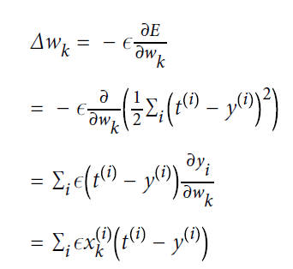
The Delta Rule and Learning Rates (Continued…)

Slide 18

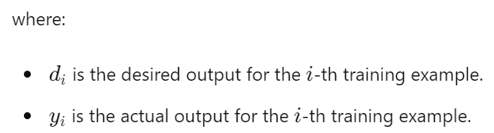
Delta Rule Derivation
Objective: Minimize the error function E for a single neuron.
The error function is typically defined as the mean squared error (MSE):

Slide 19

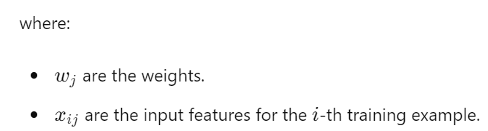
Delta Rule Derivation (continued…)
Output Calculation:
The actual output calculated using the activation function.
For simplicity, assume a linear activation function:

Slide 20

Delta Rule Derivation (continued…)
Error Gradient:
To minimize the error E, we need to adjust the weights
This is done using gradient descent
The gradient of the error with respect to a weight w_{j}

Slide 21


Delta Rule Derivation (continued…)
Partial Derivatives:
The partial derivative of the error with respect to the output y_{i}
The partial derivative of the output y_{i} with respect to the weight w_{j}

Slide 22
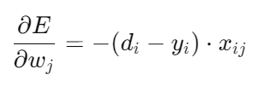
Delta Rule Derivation (continued…)
Combining the Derivatives:

Slide 23

Delta Rule Derivation (continued…)
Weight Update Rule:
Using gradient descent, the weights are updated in the direction that reduces the error.
The learning rate ε/η controls the step size of the update:

Slide 24

Delta Rule Derivation (continued…)
Final Delta Rule Equation:
Therefore, the weight update rule, known as the Delta Rule, is:
The learning rate η is a critical parameter that determines the size of the weight updates
If η is too small, the training process will be slow
If η is too large, the algorithm may oscillate and fail to converge

Slide 25
Delta Rule Derivation (continued…)
The Delta Rule is a straightforward method for updating weights in a neural network
By iteratively applying the rule to each weight
the network's error can be minimized
leading to improved performance in prediction tasks
This rule forms the basis for more complex learning algorithms in neural networks

Slide 26
The Back Propagation Algorithm
Look at Slide 1.1

Slide 27
Batch Gradient Descent
Batch Gradient Descent
The idea behind batch gradient descent is that
we use our entire dataset to compute the error surface
and then follow the gradient to take the path of steepest descent
For a simple quadratic error surface, this works quite well
But in most cases, our error surface may be a lot more complicated

Slide 28
Stochastic Gradient Descent
Stochastic Gradient Descent
At each iteration
our error surface is estimated only with respect to a single example
where instead of a single static error surface, our error surface is dynamic
As a result, descending on this stochastic surface significantly improves our ability to navigate flat regions

Slide 29
Stochastic Gradient Descent (Continued…)
The stochastic error surface fluctuates with respect to the batch error surface, enabling saddle point avoidance

Slide 30
Stochastic Gradient Descent (Continued…)
The major pitfall of stochastic gradient descent
looking at the error incurred one example at a time may not be a good enough approximation of the error surface
This, in turn, could potentially make gradient descent take a significant amount of time

Slide 31
Minibatch Gradient Descent
Minibatch Gradient Descent
In mini-batch gradient descent, at every iteration
we compute the error surface with respect to some subset of the total dataset (instead of just a single example)
This subset is called a minibatch, and in addition to the learning rate, minibatch size is another hyperparameter

Slide 32

Here, instead of summing over all the examples in the dataset
we sum over the examples in the current minibatch

